Slide 1
QuoteR:A Benchmark of Quote Recommendation for Writing
Team NO: 12
Name: Puspita Das
ID: 20301246
Sec: 01
ST & RA: Farah & Amit

Slide 2
Outline
Introduction
Motivation
Contribution
Methodology
Dataset
Result
Conclusion
Limitation
Synthesis

Slide 3
Introduction
Representation of quotes as universal among languages and task of quotes recommendation
Unablity and disadvantage to use search engines in quote recommendation
Quote recommendation dataset QuoteR use to remove closed dataset
Proposing a quote recommendation model which outperforms and performs as a strong baseline

Slide 4
Motivation
Focusing on the recommendation of quotes that fits well in context
Works on quote recommendation in Twitter dialog threads
Content-based recommendation aims to recommends product
Brings the structured data or document

Slide 5
Contribution
Fitting the recommendation quotes
Evaluated on various datasets but chose to stay in QuoteR
English, Standard Chinese and Classical Chinese are included in new recommendation dataset

Slide 6
Methodology
BERT model encodes contexts and quotes into vector representation, as well as finds similarity between query context and a candidate quote
Presenting quotes into the form of quote representation matrix Q = [q1, · · · , q|Q| ].
Inserting additional separator token for left and right context and finally obtaining candidate quote form of p = softmax(Q^⊤c)
Using raw pre-trained BERT, the pseudo-rank score of q is
p ∗ = e^(q·c)/ (e^(q·c )+ ΣP q ∗∈N(q) e^(q∗·c))
A sememe knowledge represents as a general, more convenient and reliable where minimum number of meaning of words existed

Slide 7
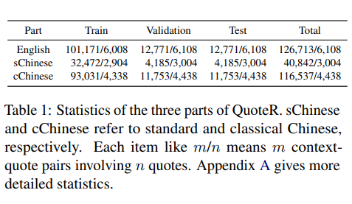
Dataset
Achieving 126,713 context-quote pairs where 6,108 different quotes are involved, which form the English part of QuoteR.
Obtaining the standard Chinese part of QuoteR, where 40,842 context-quote pairs and 3,004 different quotes are remained
Achieving 116,537 context-quote pairs where 4,438 different quotes are involved, which form the English part of QuoteR.
99/98/94 context-quote pairs are good enough for per parts.

Slide 8
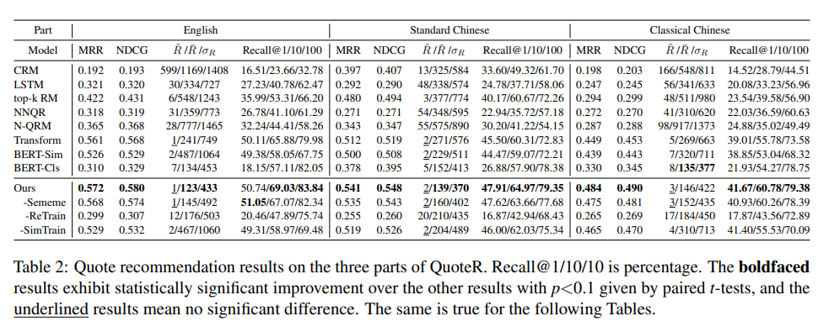
Result
Comparing three groups of models (CRM & LSTM, from top-k RM to transform and Bert-based models) to get better context of query
Evaluating three metrics and usage of BERT-based for English and Chinese
Method gives the best performances than other methods.
BERT-Sim has high performance on quote recommendation.
Approximately all methods comes up with worse result on Classical Chinese as Chinese BERT is not good to encode classical Chinese quote.

Slide 9
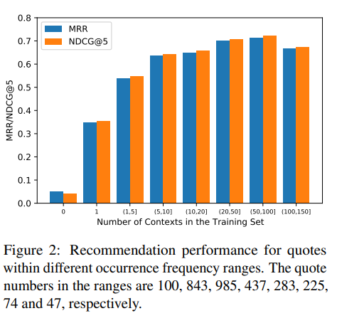
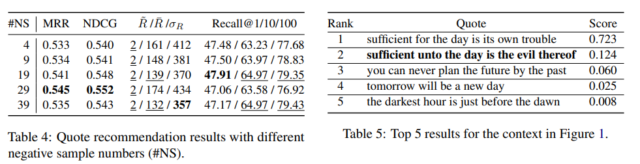
Result
Results for MRR and NDCG@5 for quotes with varying amounts of contexts in the standard Chinese part training set.
Figure 1 offers various negative sample numbers of the standard Chinese part of QuoteR where negative samples proportional to quote recommendation performance.
In Table 5, top quotes and ranks are given where the first one is alternative of gold quote and in second, gold quote comes up

Slide 10
Conclusion
There was established an uncovered dataset for writing named QuoteR and conducted an extensive evaluation.
Presents a unique model that has higher effectiveness over previous methods.

Slide 11
Limitation
First Limitation: Unable to give proper quote recommendation on small sentence type.
Second Limitation: Maximum quote recommendation dataset so unable to find more quotes or access them.

Slide 12
Synthesis
Can be enhanced model by using a special classical Chinese pre-trained model.
Improving model’s performance in the few-shot and zero-shot scenarios.
Can be used in other languages in future beside three languages.

Slide 13
Thank You

